Slide 1
Discrete Mathematics (CSC 1204)
Relations
7.1 Relations and Their Properties
7.3 Representing Relations

Slide 2
Agenda
7.1 Relations and Their Properties
Relations and Functions
Properties of Relations
Reflexive Relations
Symmetric Relations
Antisymmetric Relations
Transitive Relations
Combining Relations
Composite of Relations
7.3 Representing Relations
Representing Relations using Matrices (zero-one matrices)
Representing Relations using Directed graph (Digraph)

Slide 3
Introduction
The most direct way to express a relationship between elements of two sets is to use ordered pairs made up of two related elements. For this reason, sets of ordered pairs are called binary relations.
In this section, we introduce the basic terminology used to describe binary relations.
We can use relations to solve problems involving communications networks, project scheduling, and identifying elements in sets with common properties.

Slide 4
Binary Relations
Definition: Let A and B be sets. A binary relation from
A to B is a subset of A × B.
In other words, a binary relation from A to B is a set R of ordered pairs where the first element of each ordered pair comes from A and the second element comes from B.
We use the notation a R b to denote that (a, b)∈R
When (a, b) belongs to R, a is said to be related to b by R.
Note: a R b means a is not related to b by R, i.e., (a, b)∈ R

Slide 5
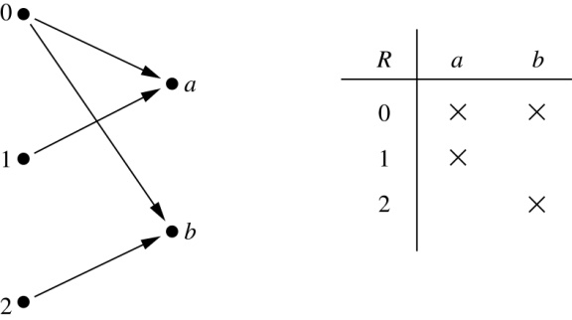
Example 3
Let A = {0,1,2} and B = {a, b} .
Then {(0, a), (0, b), (1,a) , (2, b)} is a relation from A to B.
This means, for instance, 0 R a , but that 1 R b
Relations can be represented graphically or using a table:
Note: If a relation is given as a table, the domain consists of the members of
the first column and the range consists of the members of the second column.

Slide 6
Functions as Relations
Recall that A function f from a set A to a set B assigns exactly one element of B to each element of A. The graph of f is the set of ordered pairs (a, b) such that b = f(a).
Because the graph of f is a subset of A X B, it is a relation from A to B.
Moreover, the graph of a function has the property that every element of A is the first element of exactly one ordered pair of the graph.
Conversely, if R is a relation from A to B such that every element in A is the first element of exactly one ordered pair of R, then a function can be defined with R as its graph. This can be done by assigning to an element a of A the unique element b ∈ B such that (a, b)∈R.

Slide 7
Functions VS Relations
A relation can be used to express a one-to-many relationship between the elements of the sets A and B, where an element of A may be related to more than one element of B.
A function represents a relation where exactly one element of B is related to each element of A.
Relations are more general than functions. A function is a relation where exactly one element of B is related to each element of A.

Slide 8
Relations on a Set
Relations from a set A to itself are of special interest.
Definition 2: A relation on a set A is a relation from A to A.
In other words, a relation on a set A is a subset of A × A.
Example: Suppose that A = { a, b, c}.
Then R = {(a, a),(a, b), (a, c)} is a relation on A.

Slide 9
Relations on a Set(cont.)
Example 4: Let A be the set {1, 2, 3, 4}.
Which ordered pairs are in the relation
R = {( a, b) | a divides b} ?
Solution: Because ( a, b) is in R if and only if a and b are positive integers not exceeding 4 such that a divides b, we see that
R = {(1,1), (1, 2), (1,3), (1, 4), (2, 2), (2, 4), (3, 3),(4, 4)}

Slide 10
Relations on a Set(cont.)
Example 6: How many relations are there on a set with n elements?
Solution: A relation on a set A is a subset of A X A. Because A X A has n² elements when A has n elements and a set with m elements has 2^{m} subsets, there are 2^{n2} subsets of A X A.
Thus, there are 2^{n2} relations on a set with n elements.
For example, there are 2³² = 2⁹ = 512 relations on the set {a, b, c}

Slide 11
Relations on a Set(cont.)
Example 5: Consider these relations on the set of integers:
R₁ = {(a,b) | a ≤ b}, R₄ = {(a,b) | a = b},
R₂ = {(a,b) | a > b}, R₅ = {(a,b) | a = b + 1},
R₃ = {(a,b) | a = b or a = −b}, R₆ = {(a,b) | a + b ≤ 3}.
Which of these relations contain each of the pairs
(1,1), (1, 2), (2, 1), (1, −1), and (2, 2)?
Solution: Checking the conditions that define each relation,
we see that the pair (1,1) is in R₁, R₃, R₄ , and R₆;
(1,2) is in R₁ and R₆;
(2,1) is in R₂, R₅, and R₆;
(1, −1) is in R₂, R₃, and R₆ ; (2,2) is in R₁, R₃, and R₄.

Slide 12
Properties of Relations
There are several properties that are used to classify relations on a set. We will introduce the most important of these here.
Reflexive
Symmetric
antisymmetric
Transitive

Slide 13
Reflexive Relation
Definition: A relation R on a set A is called reflexive
if (a, a)∈ R for every element a ∈ A.
Using quantifiers, a relation on the set A is reflexive
if ∀a ((a, a ) ∊ R), where universe of discourse is the set of ALL elements in A.
In a reflexive relation, every element is related to itself.
i.e. a R a for all a ∈ A
Example: The relation R = {(1, 1), (1, 2), (2, 1), (2, 2), (3, 3)} on the set {1, 2, 3}, is reflexive.

Slide 14
Determining whether a Relation is Reflexive
Example7 : Consider the following relations on {1, 2, 3, 4}:
R₁ = {(1,1), (1,2), (2,1), (2,2), (3,4), (4,1), (4,4)}
R₂ = {(1,1), (1,2), (2,1)}
R₃ = {(1,1), (1,2), (1,4), (2,1), (2,2), (3,3), (4,1), (4,4)}
R₄ = {(2,1), (3,1), (3,2), (4,1), (4,2), (4,3)}
R₅ = {(1,1), (1,2), (1,3), (1,4), (2,2), (2,3), (2,4), (3,3), (3,4), (4,4)},
R₆ = {(3,4)}.
Which of these relations are reflexive?
Solution: The relations R₃ and R₅ are reflexive because they
both contain ALL pairs of the form (a, a), namely (1,1) (2,2), (3,3)
and (4,4).

Slide 15
Reflexive Relation: Another Example
Example 8 (modified):The following relations on the set of integers are reflexive:
R₁ = {(a, b) | a ≤ b},
R₃ = {(a, b) | a = b or a = −b},
R₄ = {(a, b) | a = b}.
The following relations are NOT reflexive:
R₂ = {(a, b) | a > b} (note that 3 ≯ 3),
R₅ = {(a, b) | a = b + 1} (note that 3 ≠3 + 1),
R₆ = {(a, b) | a + b ≤ 3} (note that 4 + 4 ≰ 3).

Slide 16
Reflexive Relation
Example 9: Is the “divides” relation on the set of positive integers reflexive?
Solution: Yes. Because a | a whenever a is a positive integer, the “divides” relation is reflexive.
Question: Is the “divides” relation on the set of integers reflexive?
Solution: No. Because 0 | 0 (0 does not divide 0 )

Slide 17
Symmetric Relation
Definition: A relation R on a set A is called symmetric if (b, a)∈ R whenever (a, b)∈ R, for all a, b∈ A.
Example: The relation R = {(1,1), (1,2), (2,1), (2,2), (3,4), (4,1), (4,3), (1, 4)} on the set {1, 2, 3, 4} is symmetric.

Slide 18
Antisymmetric Relation
Definition: A relation R on a set A such that for all a, b ∊ A
if (a, b) ∊ R and (b, a) ∊ R, then a = b is called antisymmetric.
In other words, R is antisymmetric if whenever a = b, then
a R b or b R a.
It follows that R is not antisymmetric if we have a and b in A,
a = b, and both a R b or b R a.
Note: The terms symmetric and antisymmetric are NOT opposite, because a relation can have both of these properties or may lack both of them.

Slide 19
Example
Example: The following relations on the integers are
symmetric:
R₃ = {(a, b) | a = b or a = −b}
R₄ = {(a, b) | a = b}
R₆ = {(a, b) | a + b ≤ 3}
The following are NOT symmetric:
R₁ = {(a, b) | a ≤ b} (note that 3 ≤ 4, but 4 ≰ 3)
R₂ = {(a, b) | a > b} (note that 4 > 3, but 3 ≯ 4)
R₅ = {(a, b) | a = b + 1} (note that 4 = 3 + 1, but 3 ≠4 + 1)

Slide 20
Symmetric & Antisymmetric Relation: Example
Example 10 : Consider the following relations on {1, 2, 3, 4}:
R₁ = {(1,1), (1,2), (2,1), (2,2), (3,4), (4,1), (4,4)}
R₂ = {(1,1), (1,2), (2,1)}
R₃ = {(1,1), (1,2), (1,4), (2,1), (2,2), (3,3), (4,1), (4,4)}
R₄ = {(2,1), (3,1), (3,2), (4,1), (4,2), (4,3)}
R₅ = {(1,1), (1,2), (1,3), (1,4), (2,2), (2,3), (2,4), (3,3), (3,4), (4,4)},
R₆ = {(3,4)}.
Which of the relations are symmetric and which are antisymmetric?
Solution:
The relations R₂ and R₃ are symmetric.
The relations R₄ , R₅ , and R₆ are antisymmetric.
Question: What about R₁?

Slide 21
Transitive Relation
Definition: A relation R on a set A is called transitive
if whenever (a, b)∈ R and (b, c)∈ R, then (a, c)∈ R, for all a, b, c ∈ A.
Example : The relation R = {(1,1), (1,2),(1, 3), (1, 4), (2,2), (2,3), (2, 4), (3, 3), (3,4), (4, 4)} on the set {1, 2, 3, 4} is transitive.

Slide 22
Transitive Relation: Example 13
Consider the following relations on {1, 2, 3, 4}:
R₁ = {(1,1), (1,2), (2,1), (2,2), (3,4), (4,1), (4,4)}
R₂ = {(1,1), (1,2), (2,1)}
R₃ = {(1,1), (1,2), (1,4), (2,1), (2,2), (3,3), (4,1), (4,4)}
R₄ = {(2,1), (3,1), (3,2), (4,1), (4,2), (4,3)}
R₅ = {(1,1), (1,2), (1,3), (1,4), (2,2), (2,3), (2,4), (3,3), (3,4), (4,4)},
R₆ = {(3,4)}.
Which of the relations are transitive?
Solution: R₄ , R₅ & R₆ : transitive ⇐ verify that if (a, b) and (b, c) belong to this relation then (a, c) belongs also to the relation. R₄ transitive since (3,2) and (2,1), (4,2) and (2,1), (4,3) and (3,1), and (4,3) and (3,2) are the only such sets of pairs, and (3,1) , (4,1) and (4,2) belong to R₄. Same reasoning for R₅ and R₆.
R₁ : not transitive ⇐ (3,4) and (4,1) belong to R₁, but (3,1) does not.
R₂ : not transitive ⇐ (2,1) and (1,2) belong to R₂, but (2,2) does not.
R₃ : not transitive ⇐ (4,1) and (1,2) belong to R₃, but (4,2) does not.

Slide 23
Transitive Relation: Another Example
Is the relation R = { (a, a), (b, c), (c, b), (d, d)} on the set X = {a, b, c, d} is transitive?
Solution:
No. Because (b, c) and (c, b) are in R, but (b, b) is not in R

Slide 24
Combining Relations
Because relations from A to B are subsets of A X B, two relations from A to B can be combined in any way two sets can be combined.
Given two relations R₁ and R₂, we can combine them using basic set operations to form new relations such as R₁∪R₂, R₁∩R₂, R₁− R₂, and R₂ − R₁.

Slide 25
Combining Relations : Example
Example: Let A = {1,2,3} and B = {1,2,3,4}. The relations
R₁ = {(1,1),(2,2),(3,3)} and R₂ = {(1,1),(1,2),(1,3),(1,4)} can be combined using basic set operations to form new relations:
R₁ ∪ R₂ ={(1,1),(1,2),(1,3),(1,4),(2,2),(3,3)}
R₁ ∩ R₂ ={(1,1)}
R₁ − R₂ ={(2,2),(3,3)}
R₂ − R₁ ={(1,2),(1,3),(1,4)}

Slide 26
Composite of Relations
Let R be a relation from A to B and S a relation from B to a set C. The composite of R and S is the relation consisting of ordered pairs (a, c), where a ∈ A, c ∈ C, and for which there exists an element b ∈ B such that (a,b) ∈ R and (b, c) ∈ S.
We denote the composite of R and S by S ∘ R
Note: Computing the composite of two relations requires that we find elements that are the
second elements of ordered pairs in the first relation, and
first element of ordered pairs in the second relation

Slide 27
Composite of Relations : Example
Example 20 : What is the composite of the relations R and S, where R is the relation from {1, 2, 3} to {1, 2, 3, 4} with
R = {(1,1), (1,4), (2,3), (3,1), (3,4)} and S is the relation from
{1, 2, 3, 4} to {0, 1, 2} with S = {(1,0), (2,0), (3,1), (3,2), (4,1)}?
Solution: S ∘ R is constructed using all ordered pairs in R and ordered pairs in S, where the second element of the ordered pair in R agrees with the first element of the ordered pair in S. For example, the ordered pairs (2,3) in R and (3,1) in S produce the ordered pair (2,1) in S ∘ R. Computing all the ordered pairs in the composite, we find
S ∘ R = {(1,0), (1,1),(2,1), (2,2),(3,0), (3,1) }

Slide 28
Exercise 30
Let R be the relation {(1,2), (1,3),(2,3), (2,4),(3,1)}, and let S be the relation {(2,1), (3,1),(3,2), (4,2)}.
Find S ∘ R
Solution: Try out yourself!
Answer: S ∘ R = {(1,1), (1,2),(2,1), (2,2)}

Slide 29
Representing Relations
Section 7.3

Slide 30
Representing Relations
There are many ways to represent a relation between finite sets. One way is to list its ordered pairs, another way is to use a table (we have covered already)
In this section we will discuss two alternative methods of representing relations –
Representing Relations using Matrices (zero-one matrices)
Representing Relations using Directed graph (Digraph)
All Relation we study in this section will be Binary Relations.

Slide 31
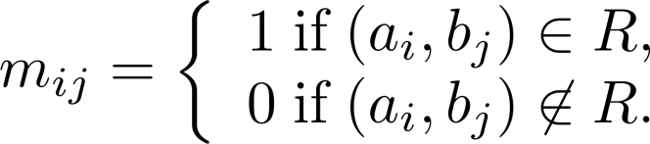
Representing Relations Using Matrices
A relation between finite sets can be represented using a zero-one matrix.
Suppose R is a relation from A = {a₁, a₂, …, a_{m}} to B = {b₁, b₂,…, b_{n}}
The elements of the two sets can be listed in any particular arbitrary order. When A = B, we use the same ordering.
The relation R is represented by the matrix M_{R} = [m_{ij}], where
The matrix representing R has a 1 as its (i,j) entry when a_{i} is related to b_{j} and a 0 if a_{i} is not related to b_{j}.

Slide 32
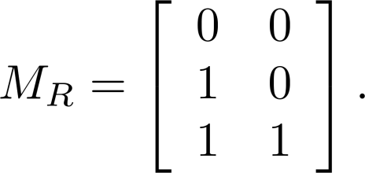
Representing Relations Using Matrices: Example1
Example 1: Suppose that A = {1,2,3} and B = {1,2}.
Let R be the relation from A to B containing (a, b) if a ∈ A,
b ∈ B, and a > b. What is the matrix representing R (assuming the ordering of elements is the same as the increasing numerical order)?
Solution: Because R = {(2,1), (3,1),(3,2)}, the matrix is
Note: The matrix of a relation R from A to B is dependent on the orderings of the A and B

Slide 33
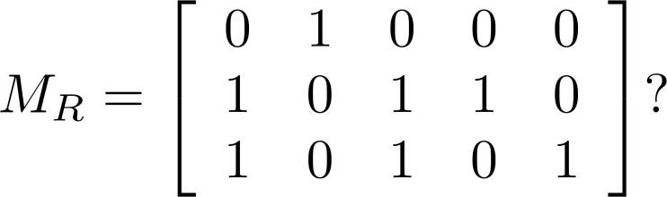
Representing Relations Using Matrices:Example2
Example 2: Let A = {a₁,a₂, a₃} and B = {b₁,b₂, b₃,b₄, b₅}.
Which ordered pairs are in the relation R represented by the
matrix
Solution: Because R consists of those ordered pairs (a_{i},b_{j}) with
m_{ij} = 1, it follows that:
R = {(a₁, b₂), (a₂, b₁),(a₂, b₃), (a₂, b₄),(a₃, b₁), {(a₃, b₃), (a₃, b₅)}

Slide 34
Matrices of Relations on Sets
If R is a reflexive relation, all the elements on the main diagonal of M_{R} are equal to 1.
The matrix of an antisymmetric relation has the property that
if m_{ij} = 1 with i = j, then m_{ji} = 0. In other words, either m_{ij} = 0 or m_{ji} = 0 when i = j
For antisymmetry, there can never be two 1’s symmetrically placed
about the main diagonal
R is a symmetric relation, if the matrix is symmetric.
if and only if m_{ij} = m_{ji} (for all pairs of integers i and j with i = 1,2,…..,n and j = 1,2,…..n)
if and only if M_{R} = (M_{R}) ^{t}
Note: (M_{R}) ^{t} is the transpose of M_{R} which is obtained by interchanging rows and columns of M_{R}

Slide 35
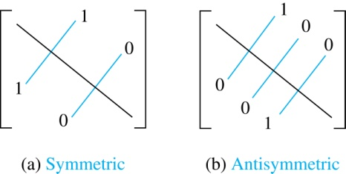

Zero-One Matrices for Different Types of Relations
Reflexive

Slide 36
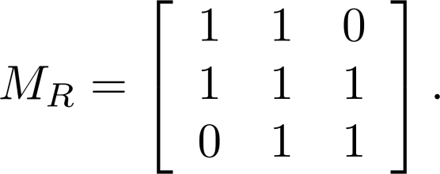
Example of a Relation on a Set
Example 3: Suppose that the relation R on a set is
represented by the matrix
Is R reflexive, symmetric, and/or antisymmetric?
Solution: Because all the diagonal elements are equal to 1, R is reflexive.
Because M_{R} is symmetric, R is symmetric.
R is not antisymmetric because both m_{1,2} and m_{2,1} are 1.

Slide 37
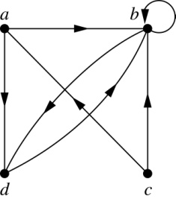
Representing Relations Using Digraphs
Definition: A directed graph, or digraph, consists of a set V of vertices
(or nodes) together with a set E of ordered pairs of elements of V
called edges (or arcs). The vertex a is called the initial vertex of the
edge (a, b), and the vertex b is called the terminal vertex of this edge.
An edge of the form (a, a) is called a loop.
Example 7: A drawing of the directed graph with vertices a, b, c, and
d, and edges (a, b), (a, d), (b, b), (b, d), (c, a), (c, b), and (d, b) is shown
below.

Slide 38
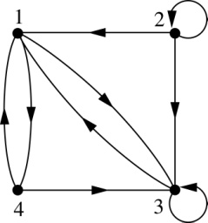
Representing Relations Using Digraphs: Example
Example: What are the ordered pairs in the
relation represented by this directed graph?
Solution: The ordered pairs in the relation are
(1, 3), (1, 4), (2, 1), (2, 2), (2, 3), (3, 1), (3, 3), (4, 1), (4, 3)

Slide 39
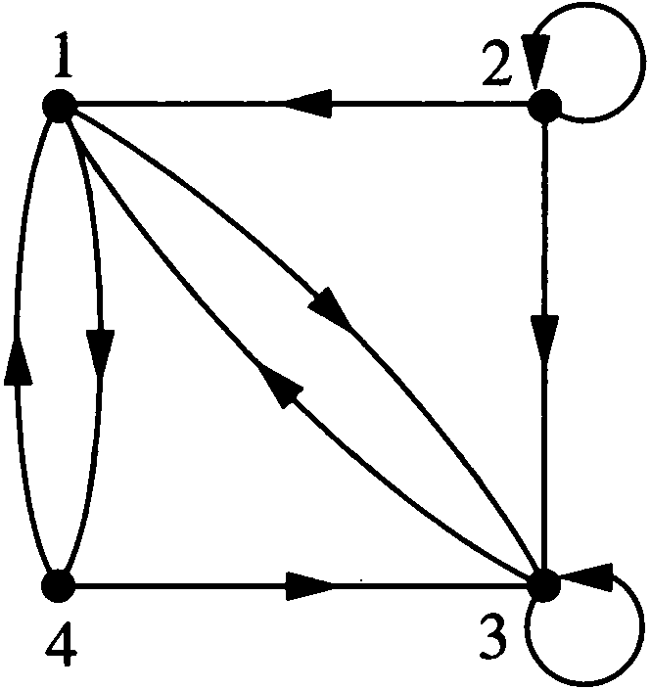
Representing Relations Using Digraphs: Example
Example 9 : What are the ordered pairs in the relation R represented by this graph?
Solution:
R = {(1,3), (1,4), (2,1), (2,2), (2,3), (3,1), (3,3), (4,1), (4,3)}

Slide 40
Determining which Properties a Relation has from its Digraph
Reflexivity: A loop must be present at ALL vertices in the graph.
Symmetry: If (x,y) is an edge, then so is (y,x).
Antisymmetry: Between any two vertices there is at most one directed edge.
Transitivity: If (x,y) and (y,z) are edges, then so is (x,z).

Slide 41
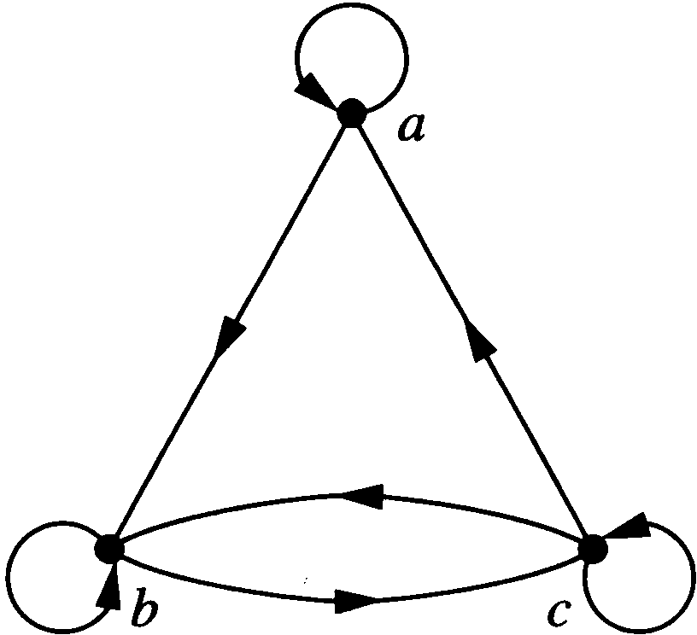
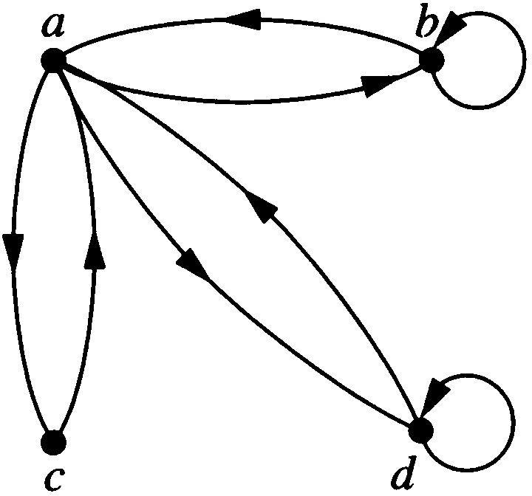
Example 10: Determine whether the relations for the directed graphs shown below are reflexive, symmetric, antisymmetric, and/or trainsitive. [Solution ➔ next slide]
(a) Directed graph of R
(a) Directed graph of S

Slide 42
Solution of Example 10
Solution of (a):
Reflexive; because there are loops at every vertex
Not symmetric; because there is an edge from a to b, but not one from b to a
Not antisymmetric; because there is an edge from b to c and an edge from c to b
Not transitive; because there is an edge from a to b and an edge from b to c, but no edge from a to c.

Slide 43
Solution of Example 10
Solution of (b):
Not Reflexive; because loops are not present at every vertex
Symmetric; because every edge between distinct vertices is accompanied by an edge in the opposite direction
Not antisymmetric; because there is an edge from a to b and an edge from b to a
Not transitive; because (c, a ) and (a, b ) belongs to S,
but (c, b) does not belong to S

Slide 44
Class Work
Draw the digraph and the matrix of the relation
R = {(1, 2), (1, 3), (2, 2), (2, 1), (3, 2), (3, 4), (4, 1),
(4, 2), (4, 4)} on the set A = {1, 2, 3, 4}.
Try it out yourself!

Slide 45
Practice @ Home
Relevant Odd-Numbered Exercises from
Section 7.1 & 7.3

